Slide 1
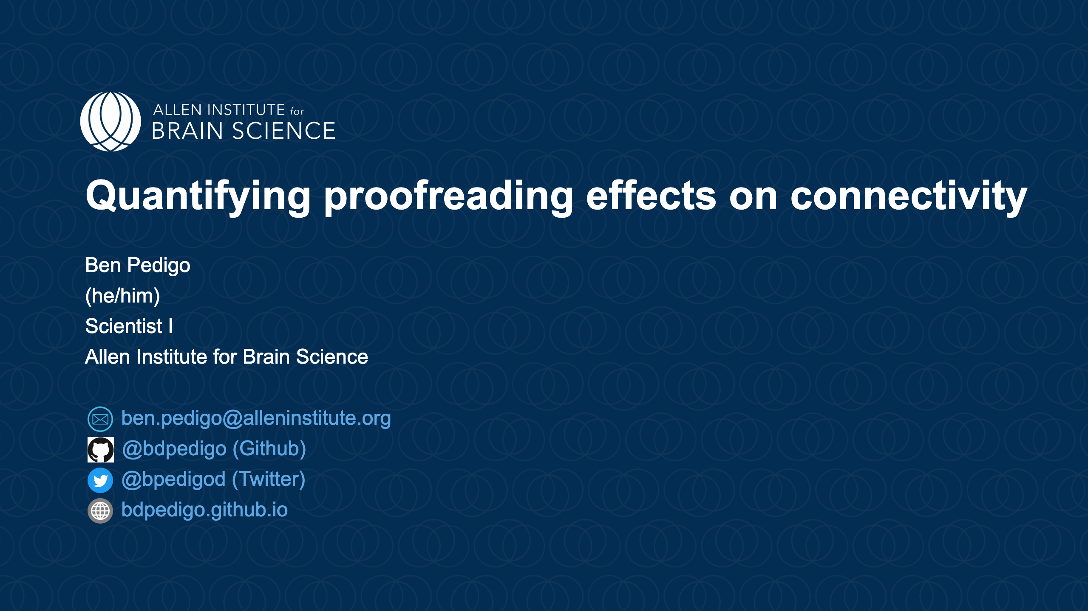
Notes:
<style> section::after { content: attr(data-marpit-pagination) '/24'; } </style> ![bg center blur:3px opacity:20%](https://raw.githubusercontent.com/bdpedigo/talks/main/docs/images/background.svg) <h1 style="margin-top: 200px;"> Connectivity properties in light of proofreading </h1> <br>

Slide 2
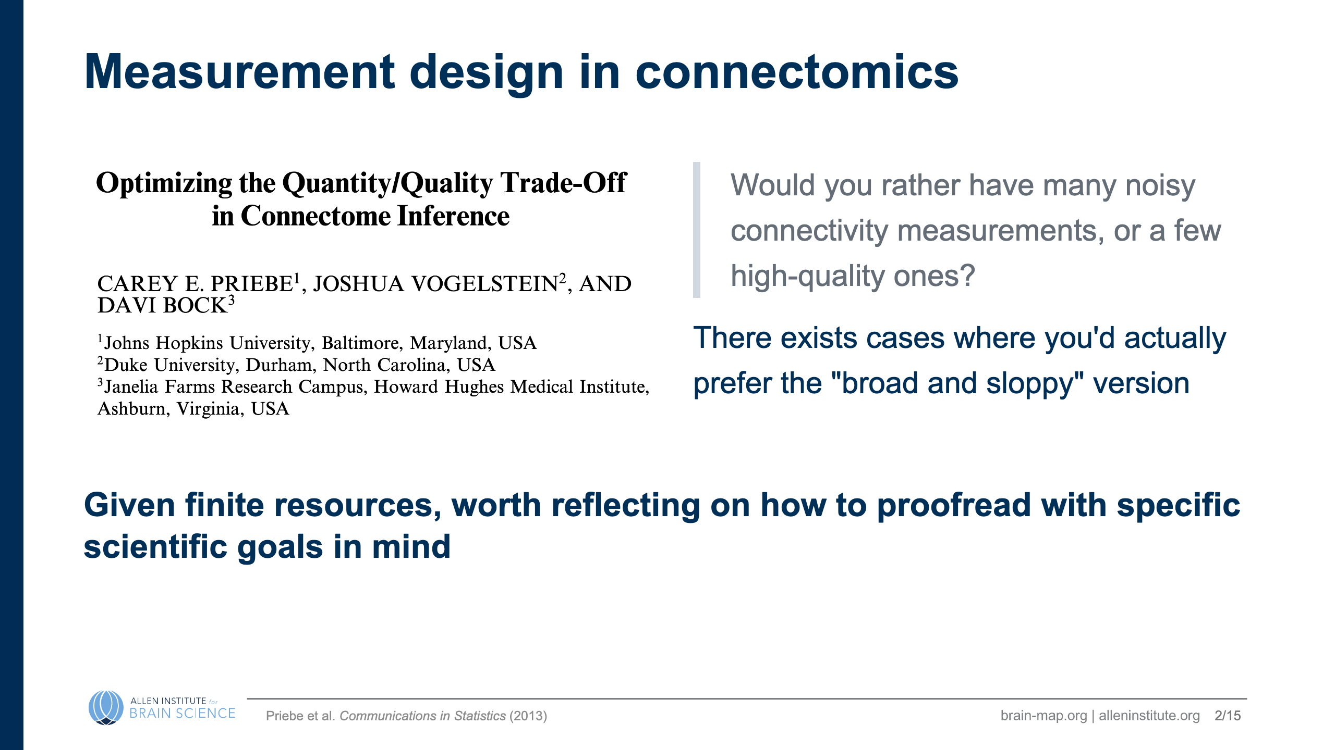

Slide 3
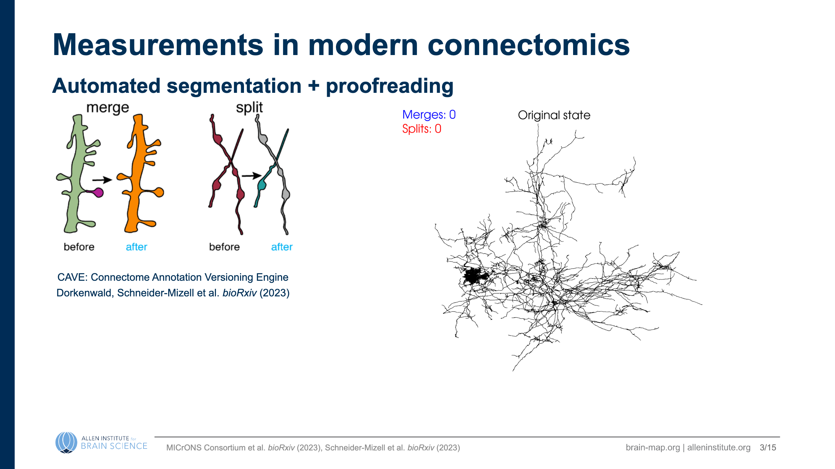
Notes:
![bg](../themes/aibs-backgrounds/Slide4.png) ### How do these edits affect downstream conclusions?

Slide 4
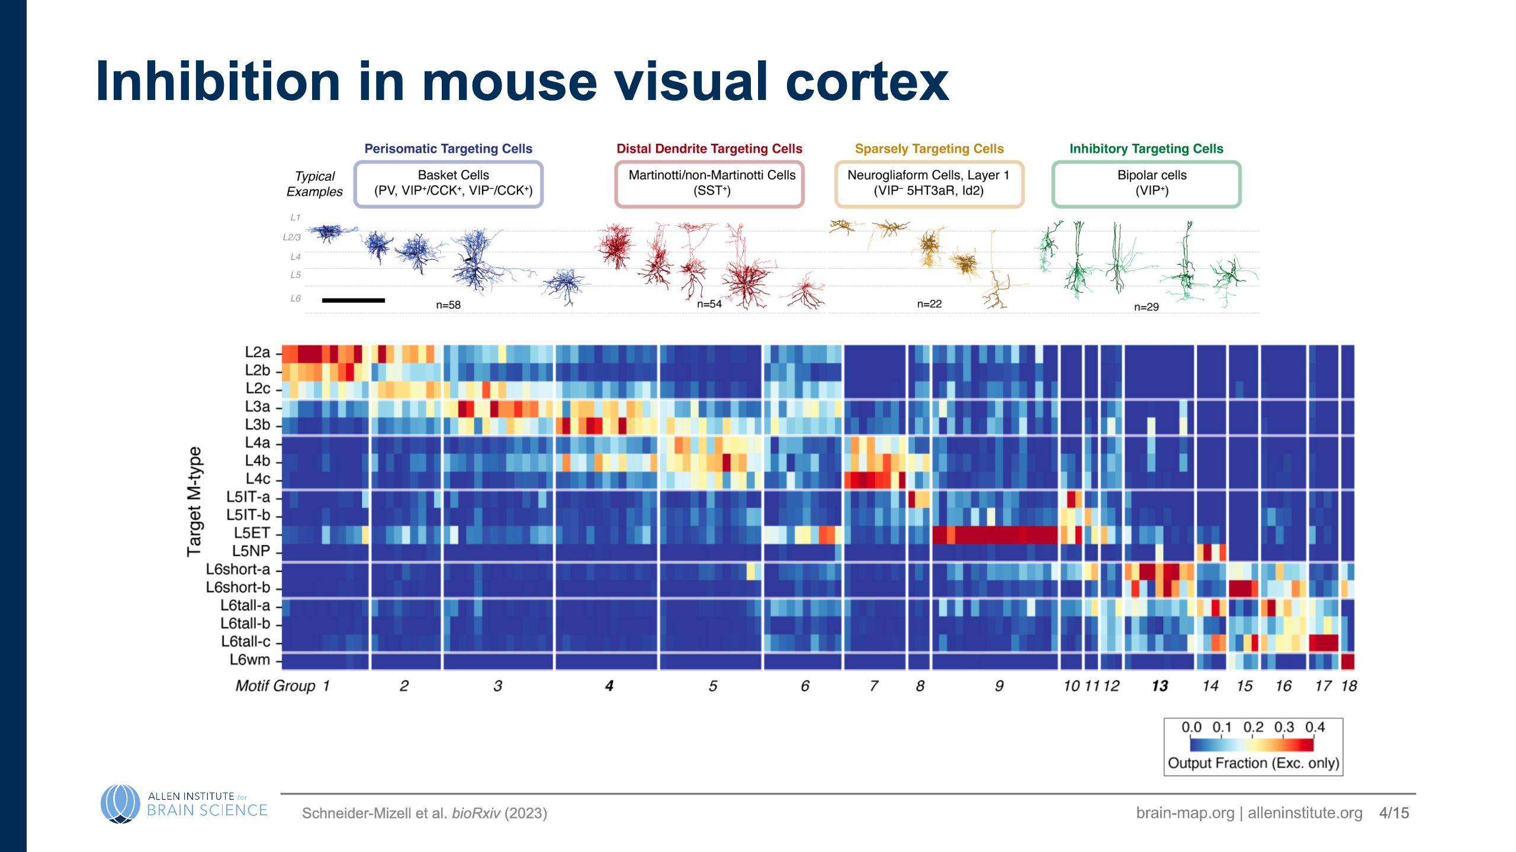
Notes:
--- # Inhibition in mouse visual cortex <div class="columns"> <div> ![](images/inhibitory-gallery.png) </div> <div> - 163 inhibitory neurons were heavily proofread - Characterized how inhibitory neurons distribute their outputs: {diagram of proportion of outputs metric} </div> </div> <!-- # CAVE allows us to extract the complete edit history ![h:500 center](./images/all_edits_by_time-root_id=864691135213953920.gif) _footer: Dorkenwald, Schneider-Mizell et al. *bioRxiv* (2023)

Slide 5
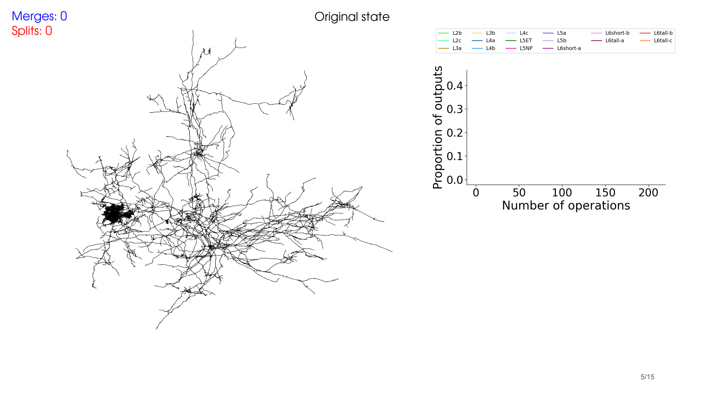
Notes:
# Connectivity during proofreading

Slide 6
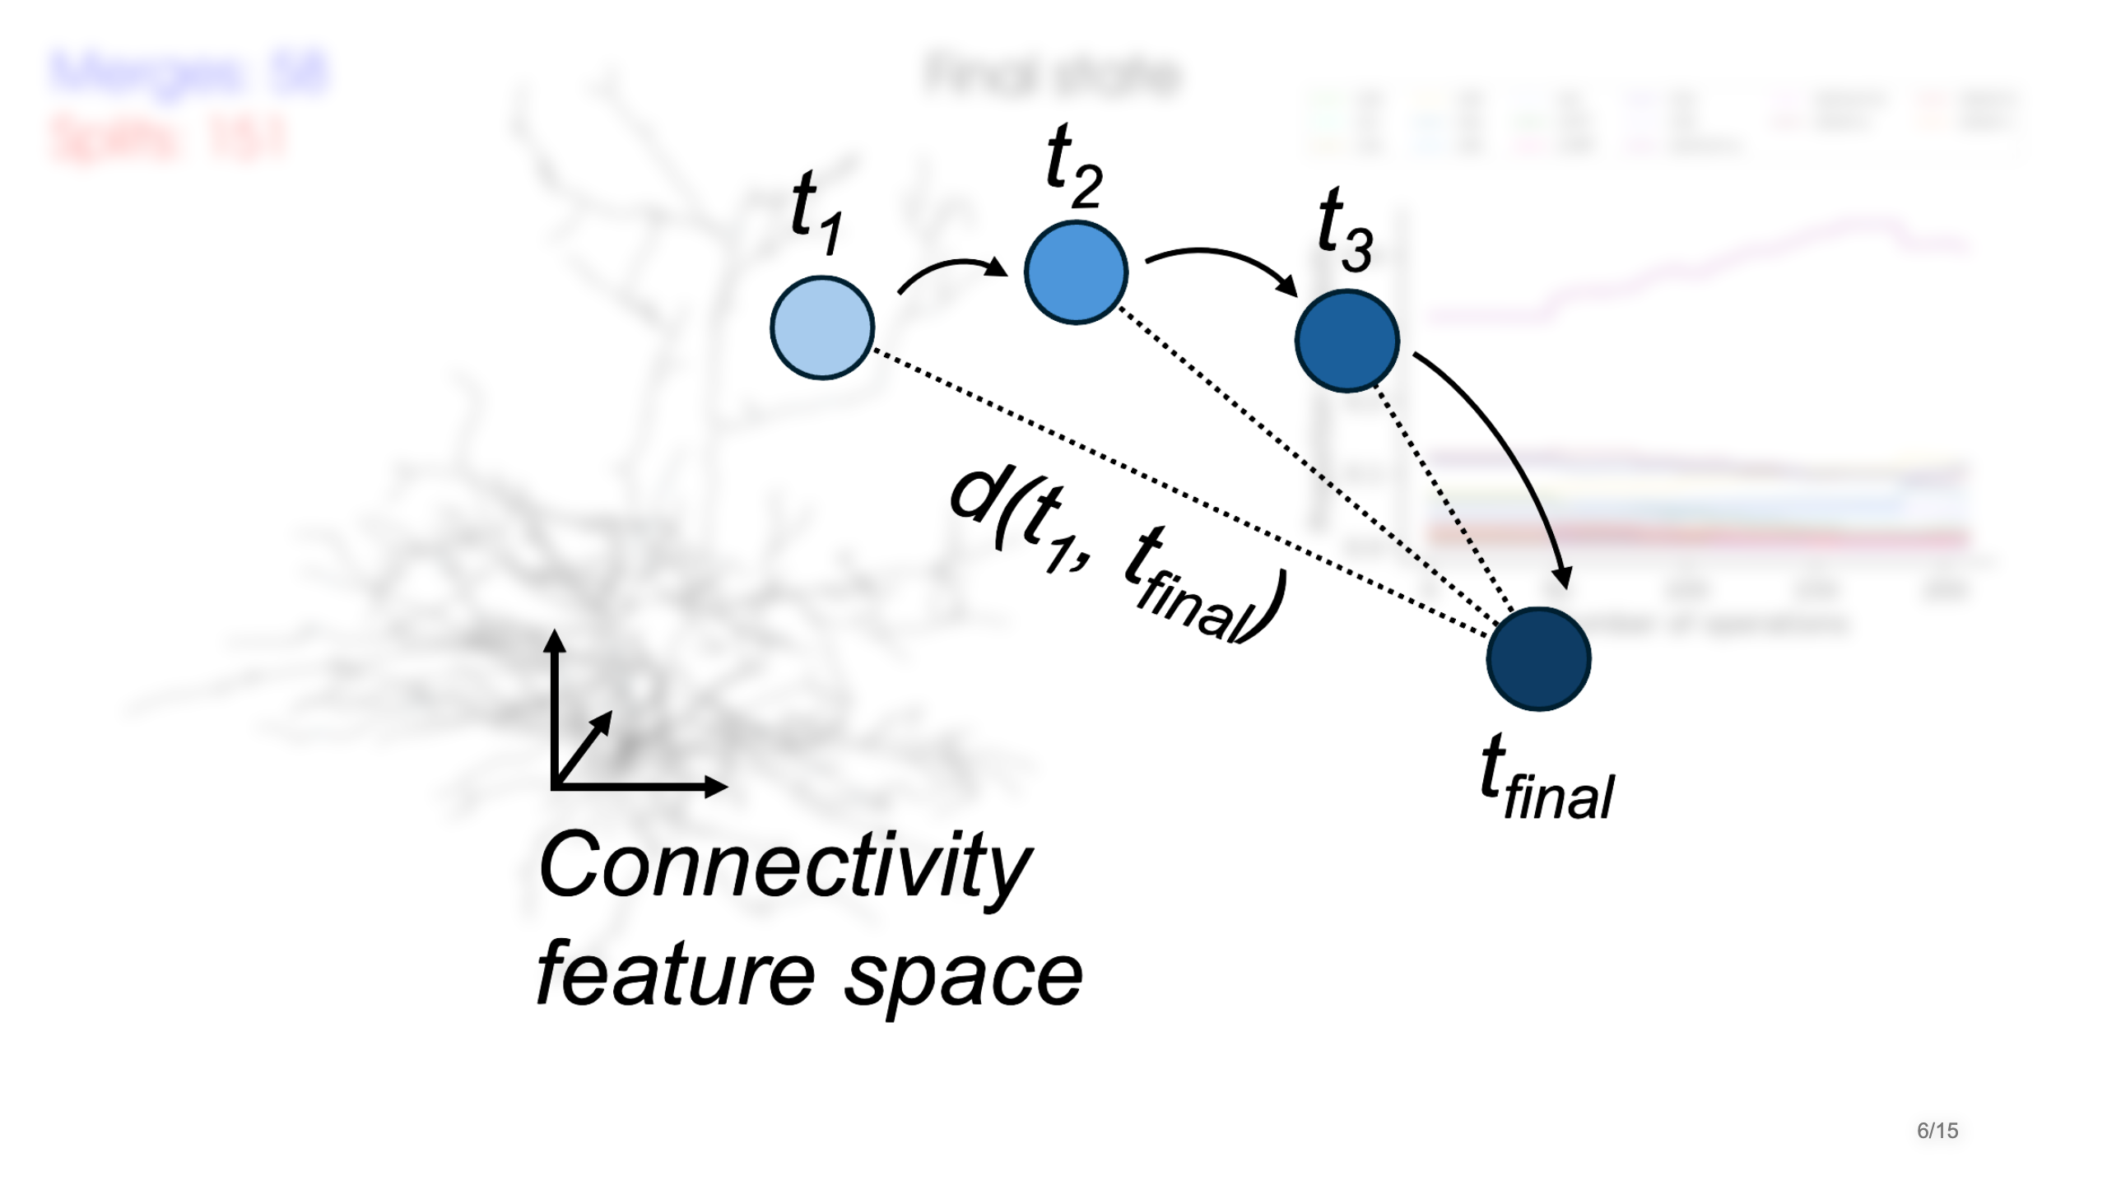
Notes:
# Connectivity during proofreading <div style="position: absolute; bottom: 20px; right: 60px;"> ![h:280](images/white.png) </div>

Slide 7
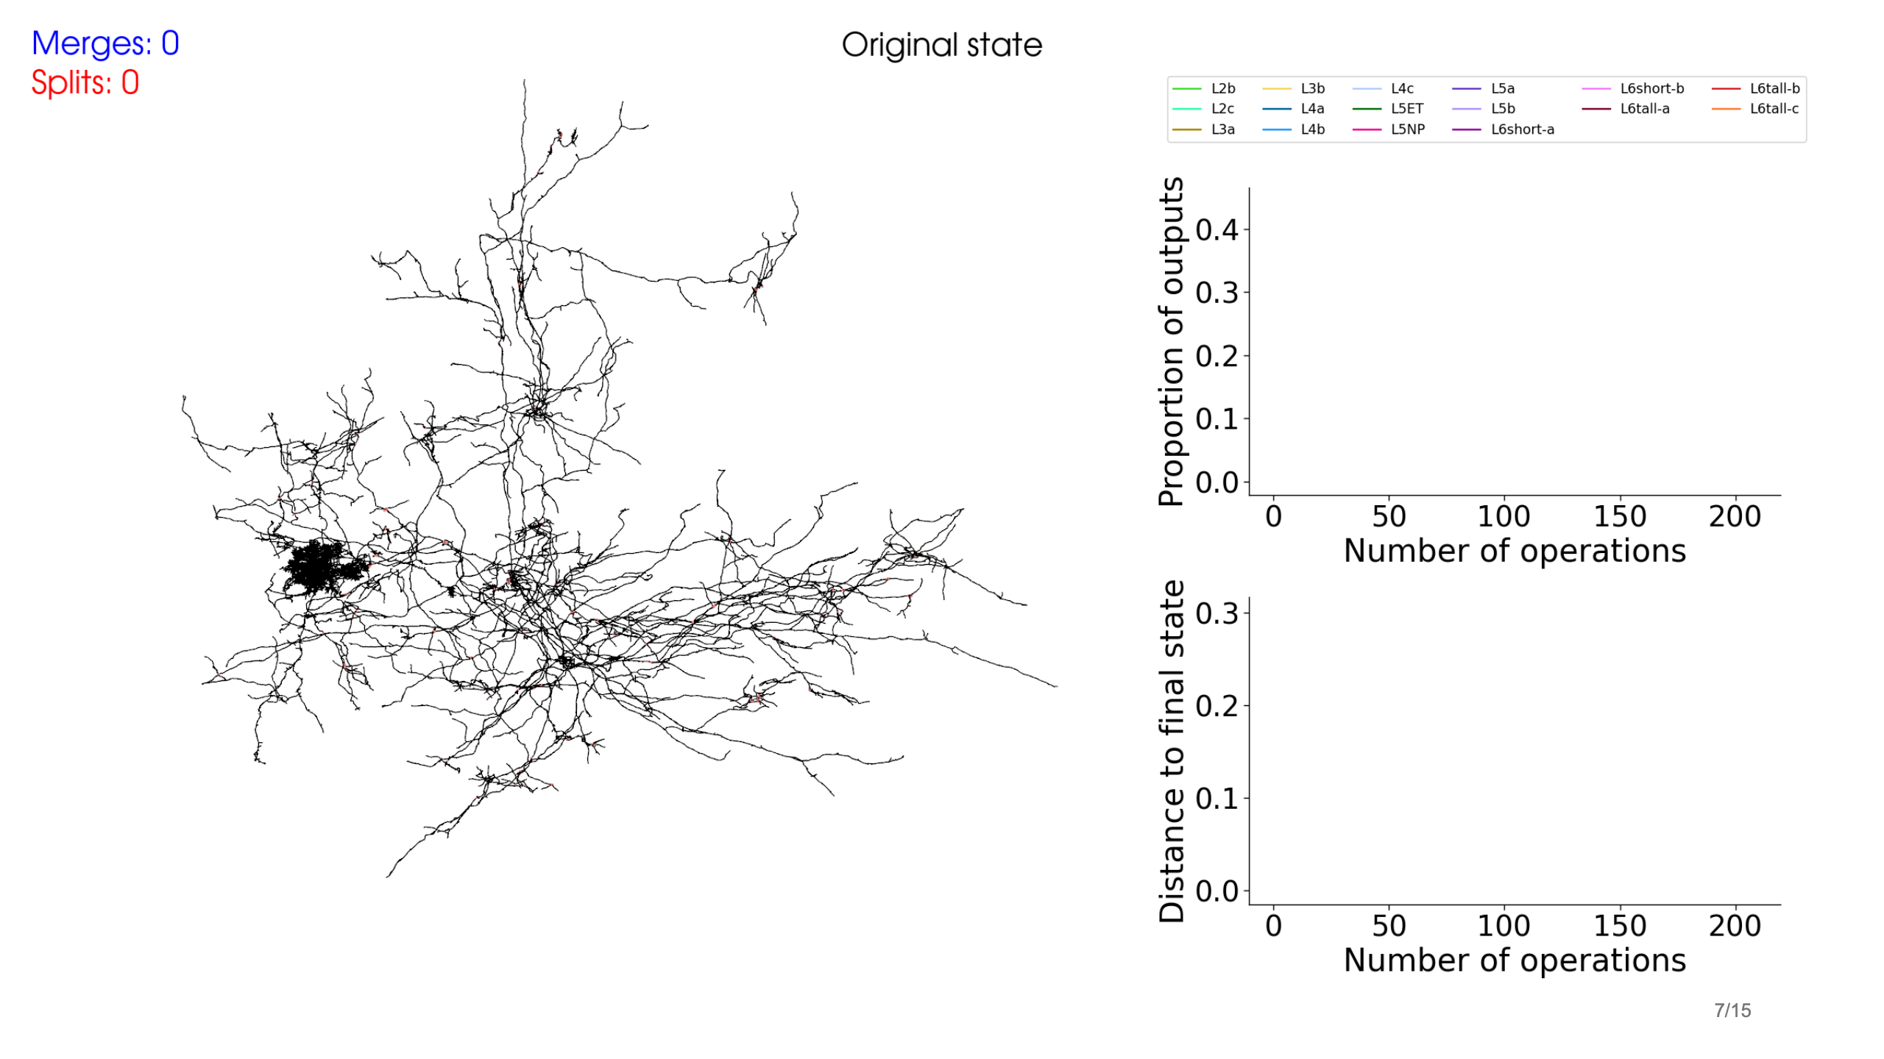

Slide 8
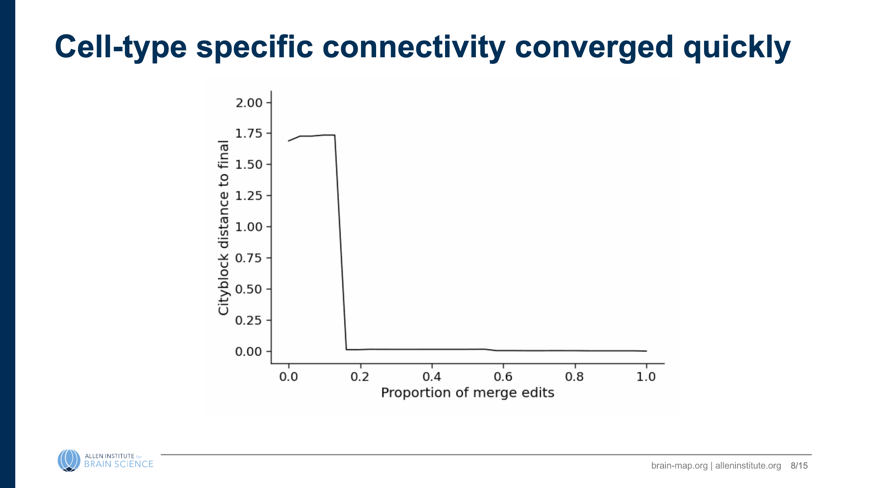

Slide 9
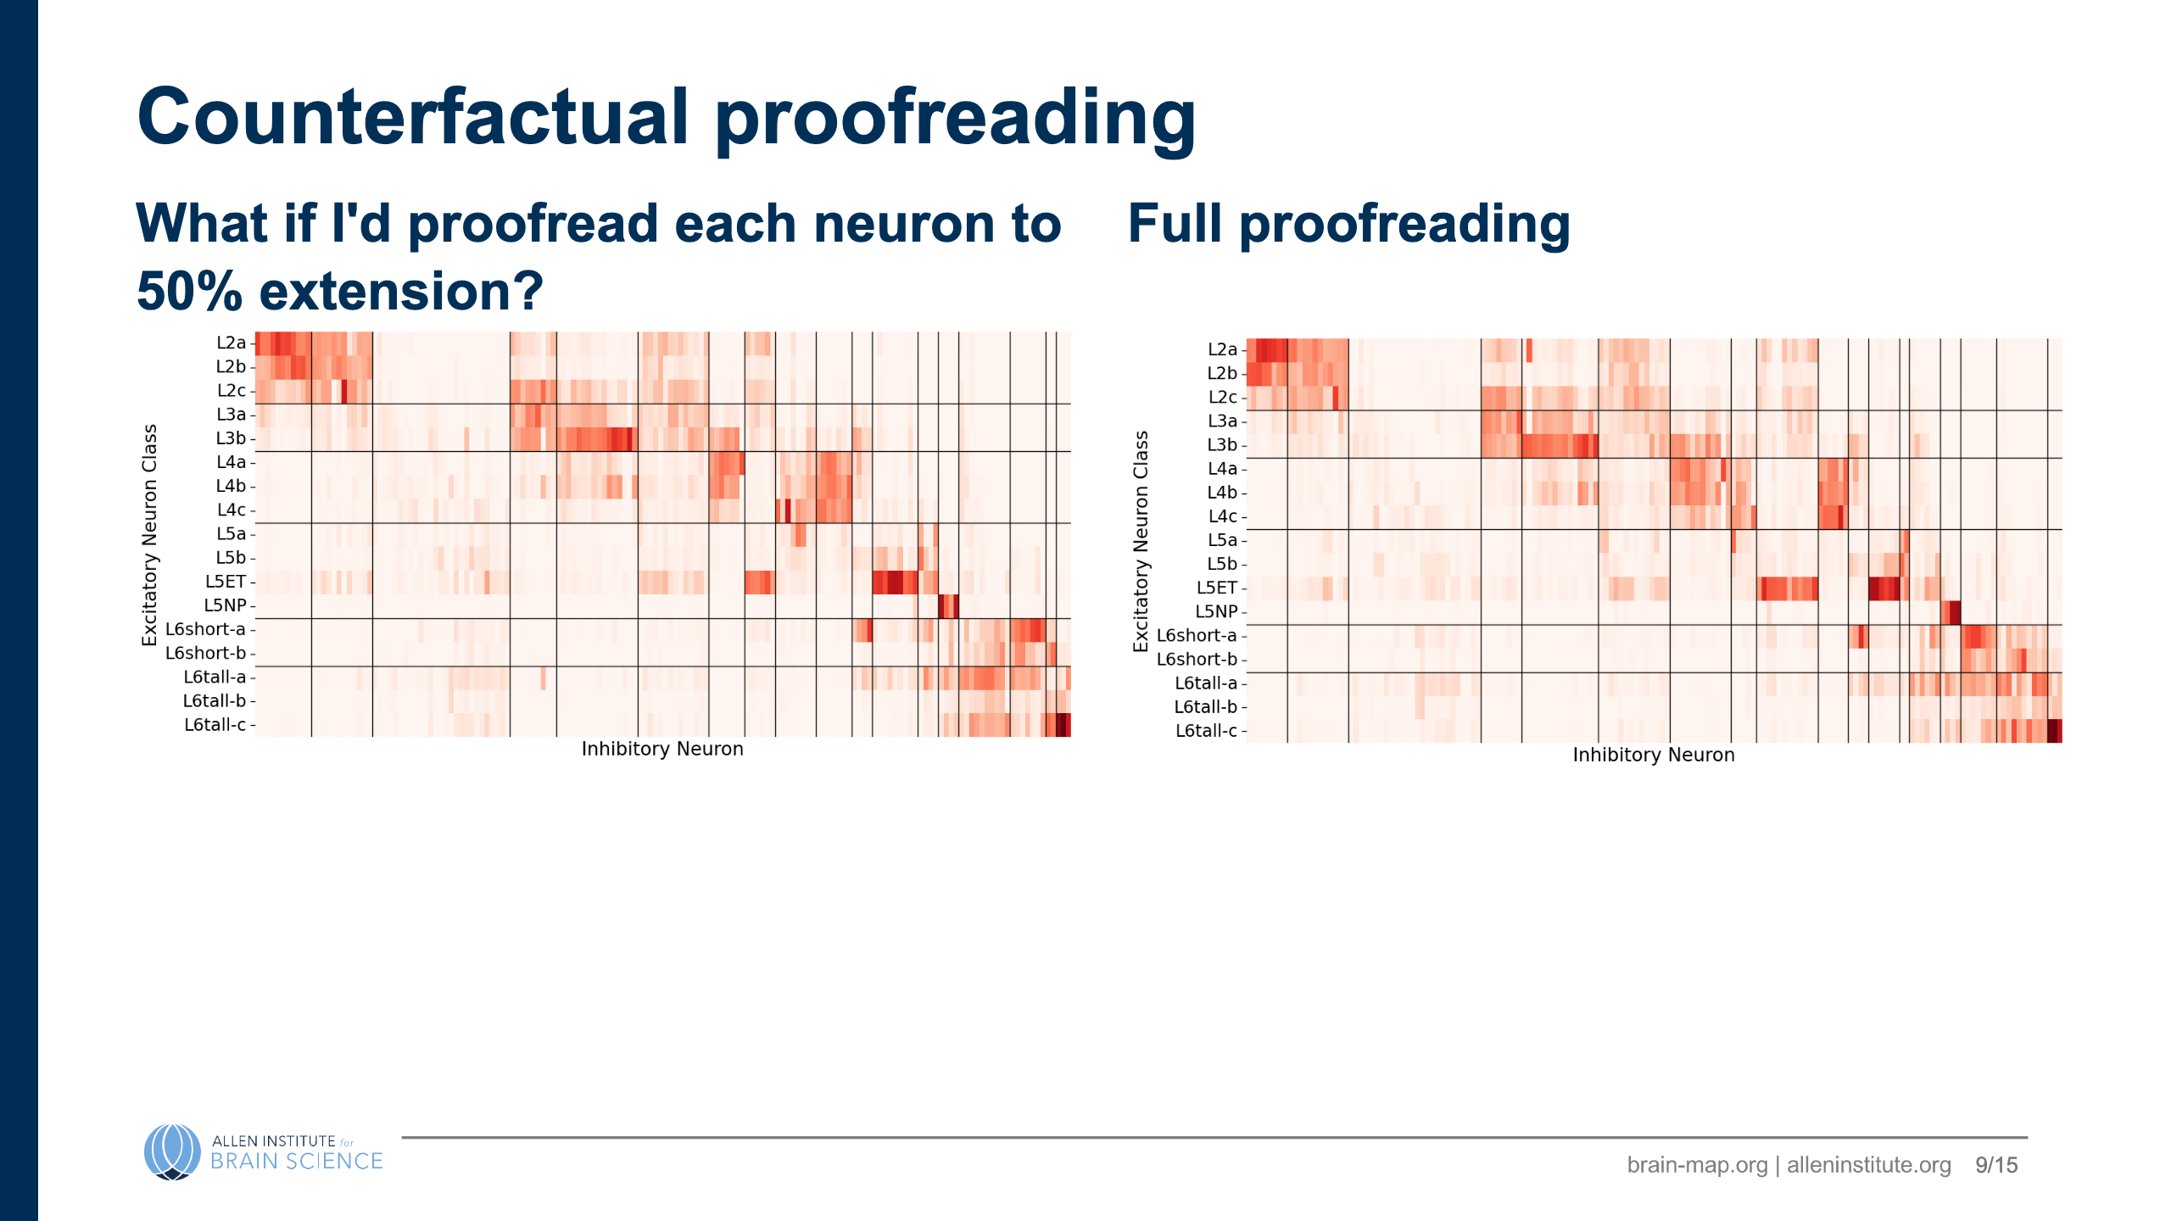
Notes:
- So far, have looked at how neurons changed over the course of proofreading in actuality, but this is a somewhat arbitrary historical ordering - Can replay edits (or not) according to alternative schemes - E.g. what if we only had half the proofreading resources - how should we allocate them?

Slide 10
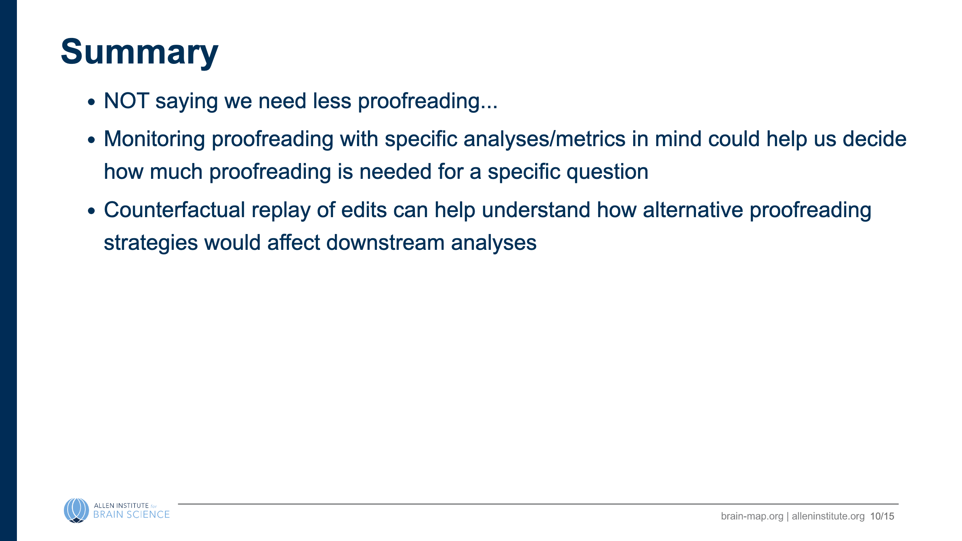
Notes:
- Worth understanding whether most neurons look like they have converged - Counterfactual replay of various edit schemes can help understand how alternative proofreading strategies might affect downstream analyses - Analyses could be applied to other datasets or even to analyze how design of automated proofreading systems affects conclusions

Slide 11
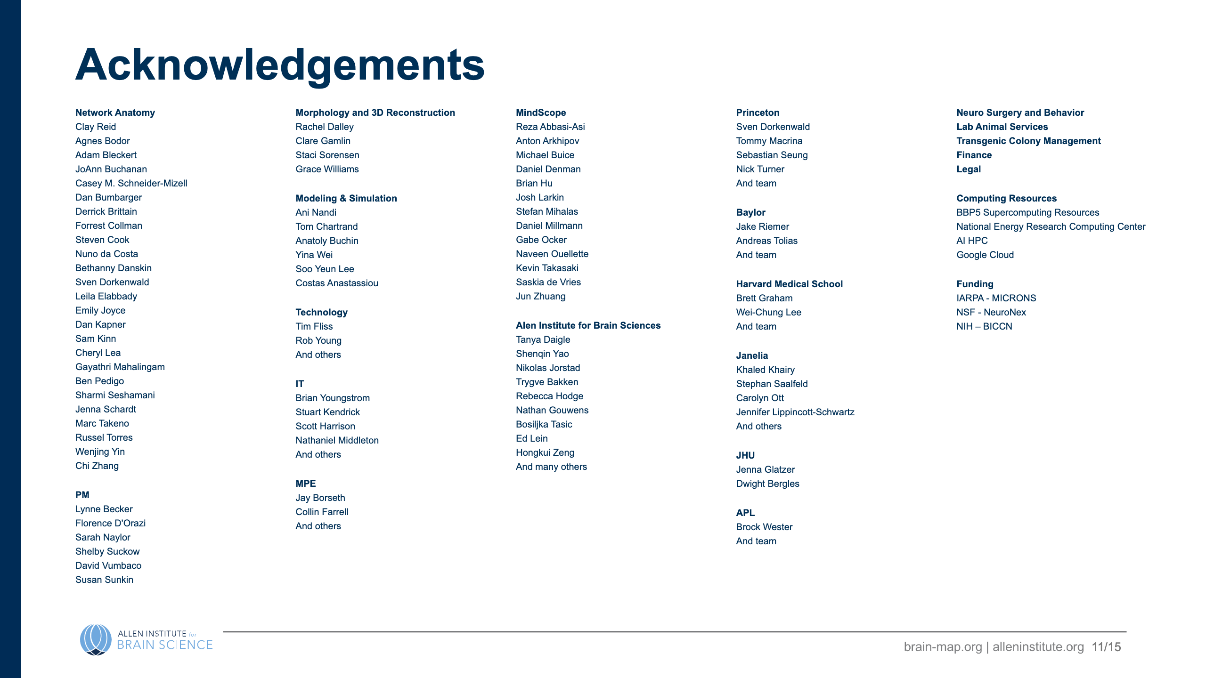

Slide 12
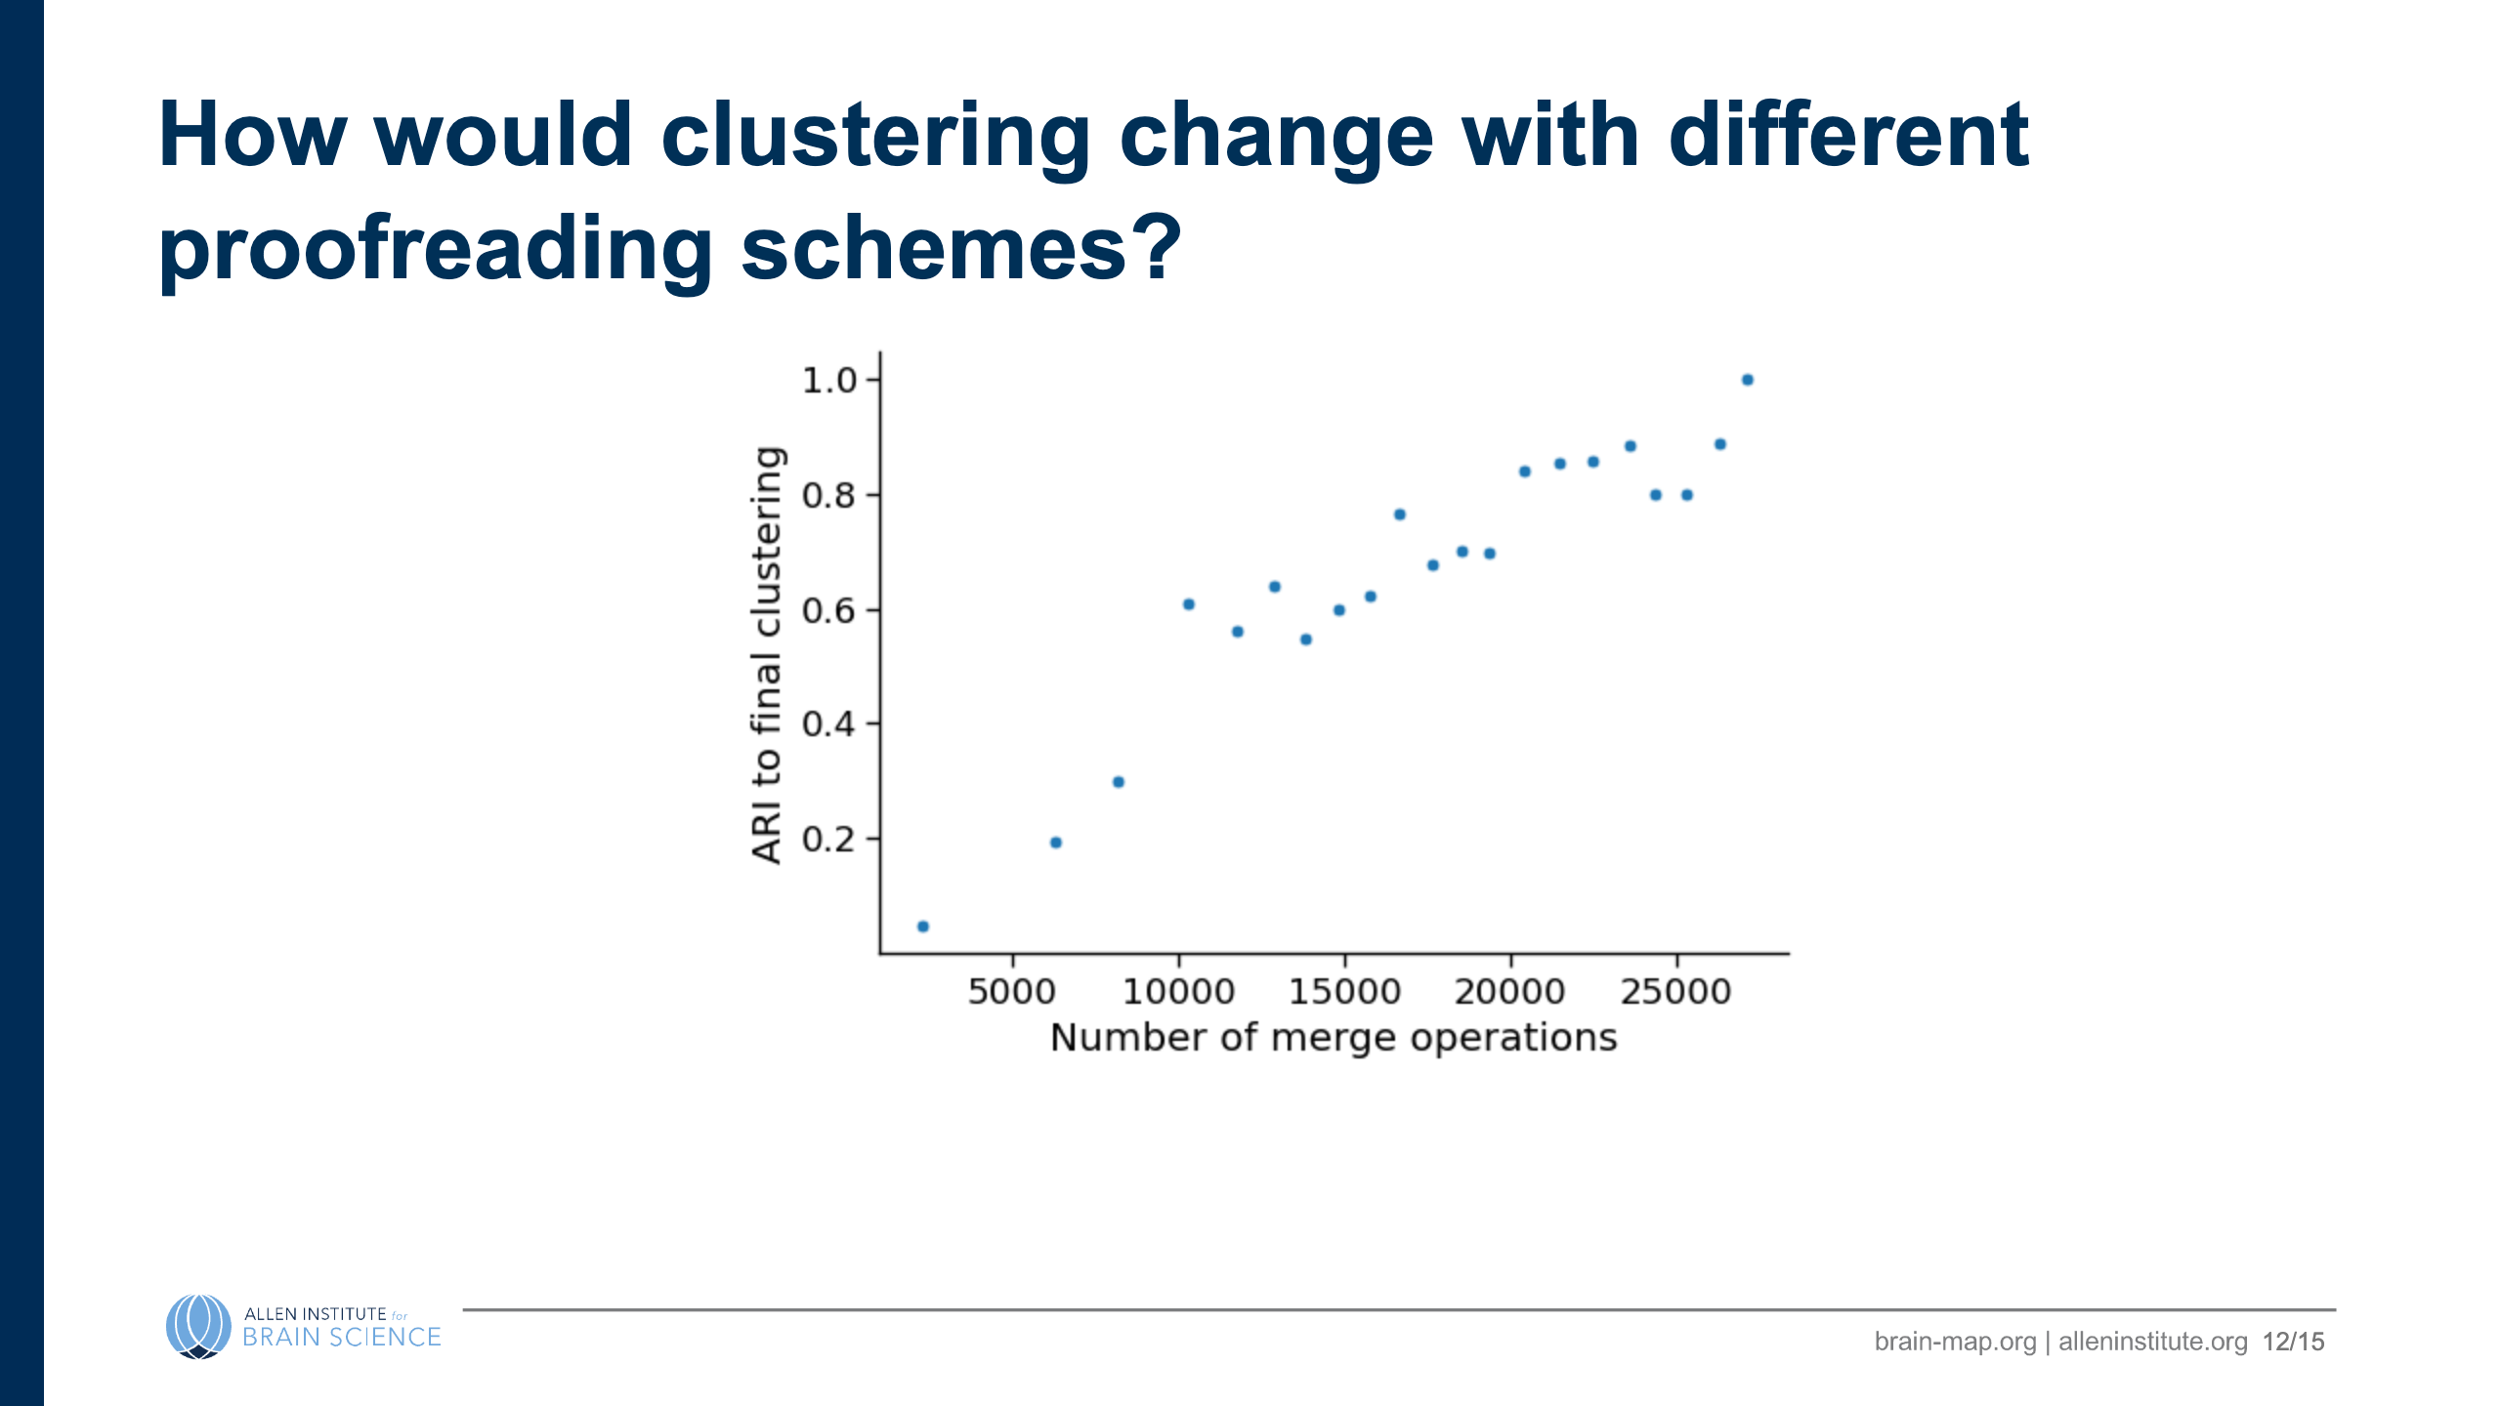

Slide 13
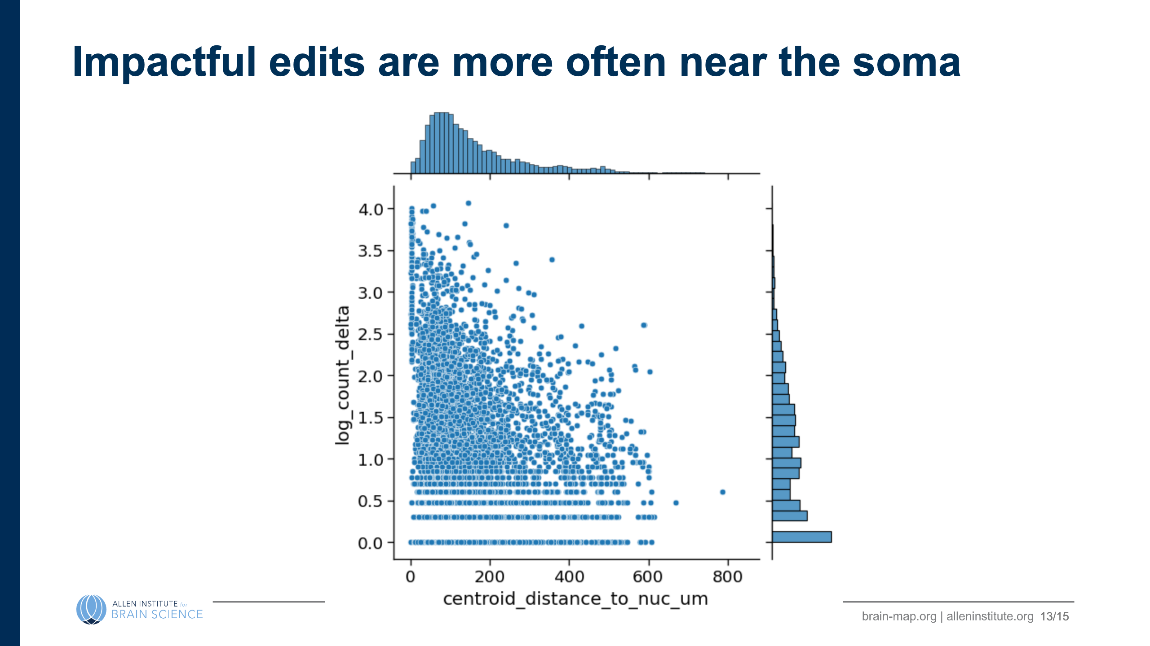

Slide 14
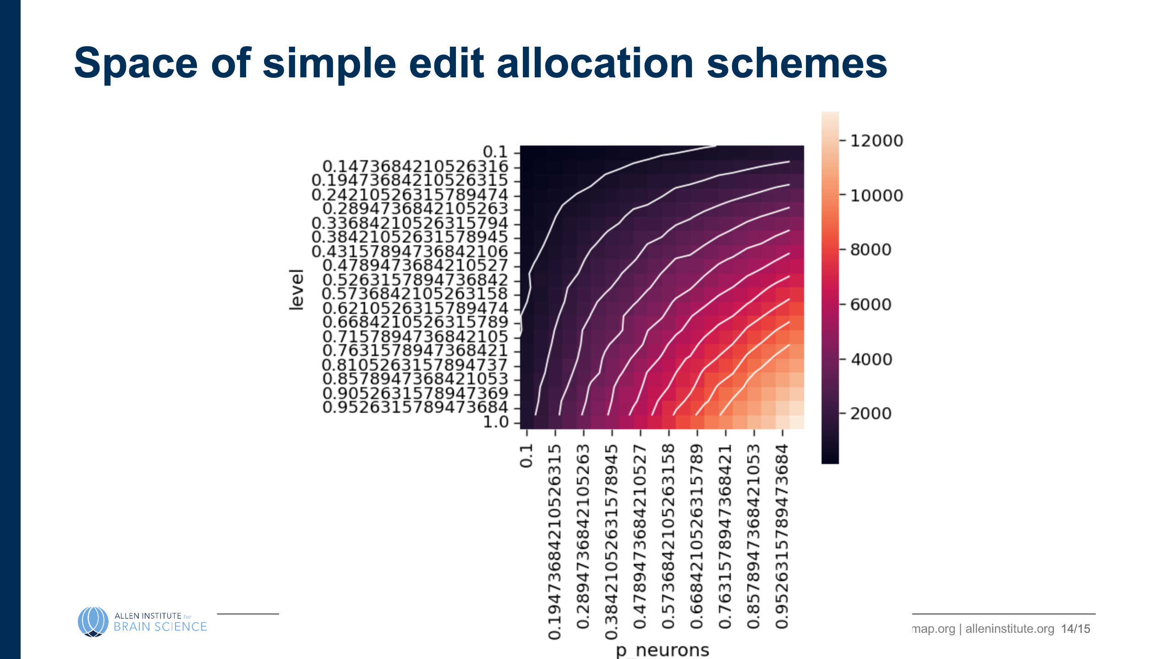
Notes:
# (1) "sloppy" proofreading? ![](images/half_edit_heatmaps.png) --- # (2) what if I omit individual edits? (importance) ![h:500 center](images/edit_dropout_importance_root_id=864691135213953920.png) --- # (3) which neurons are "good enough"? ![h:500 center](images/closeness-by-n_outputs.png)

Slide 15
